Slide 1


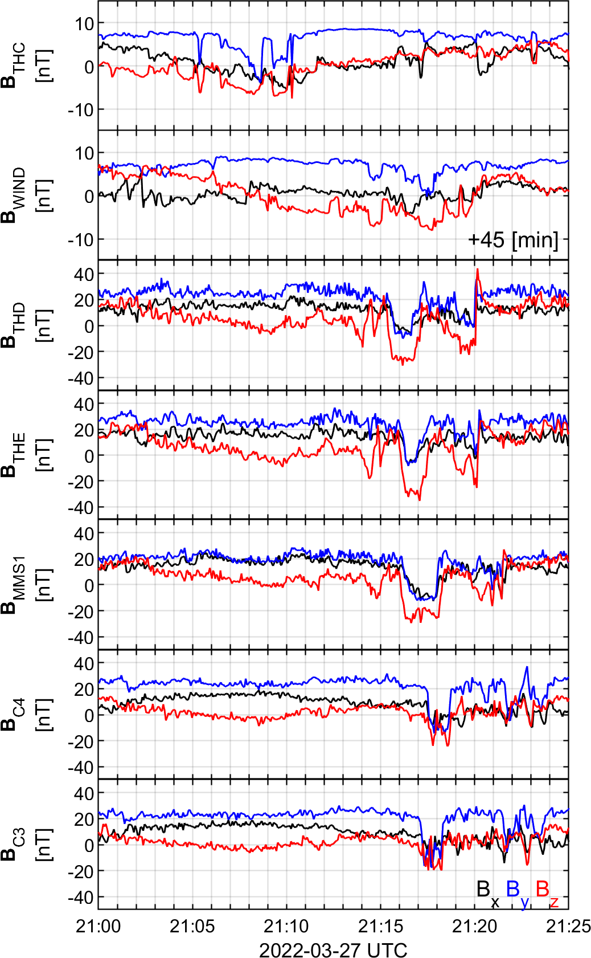
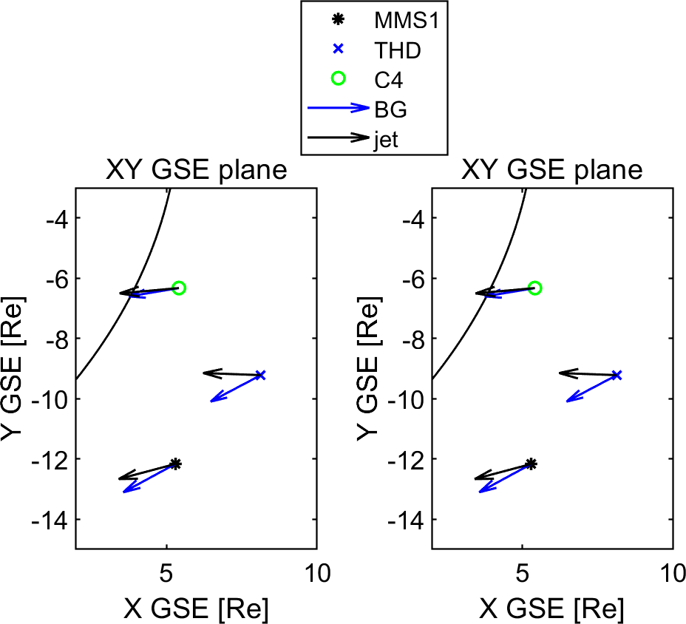
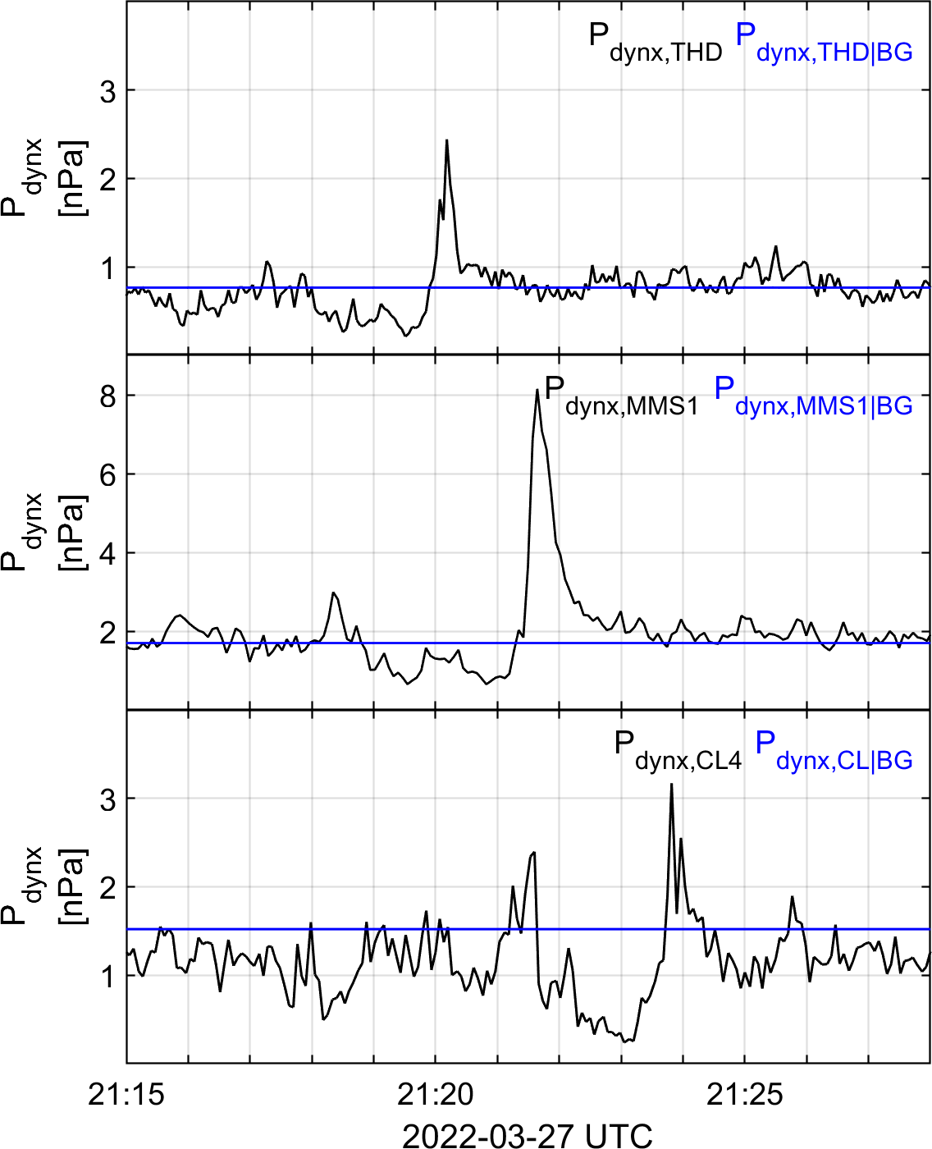
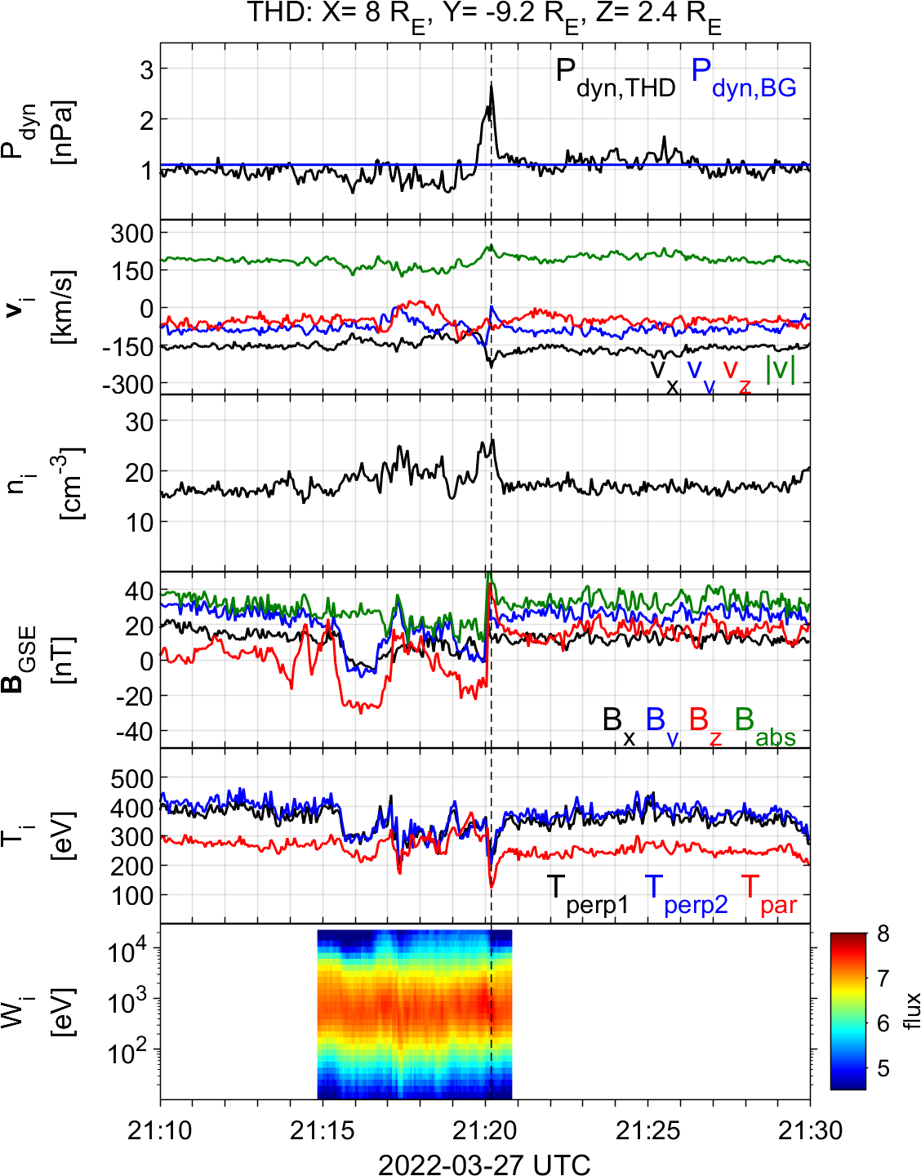




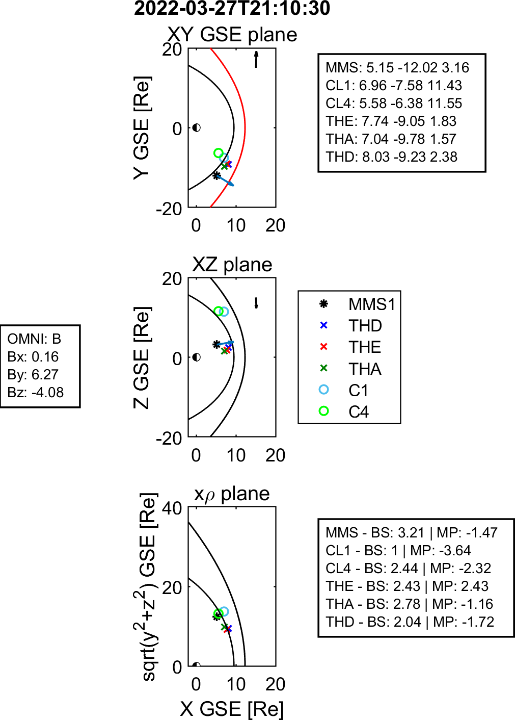
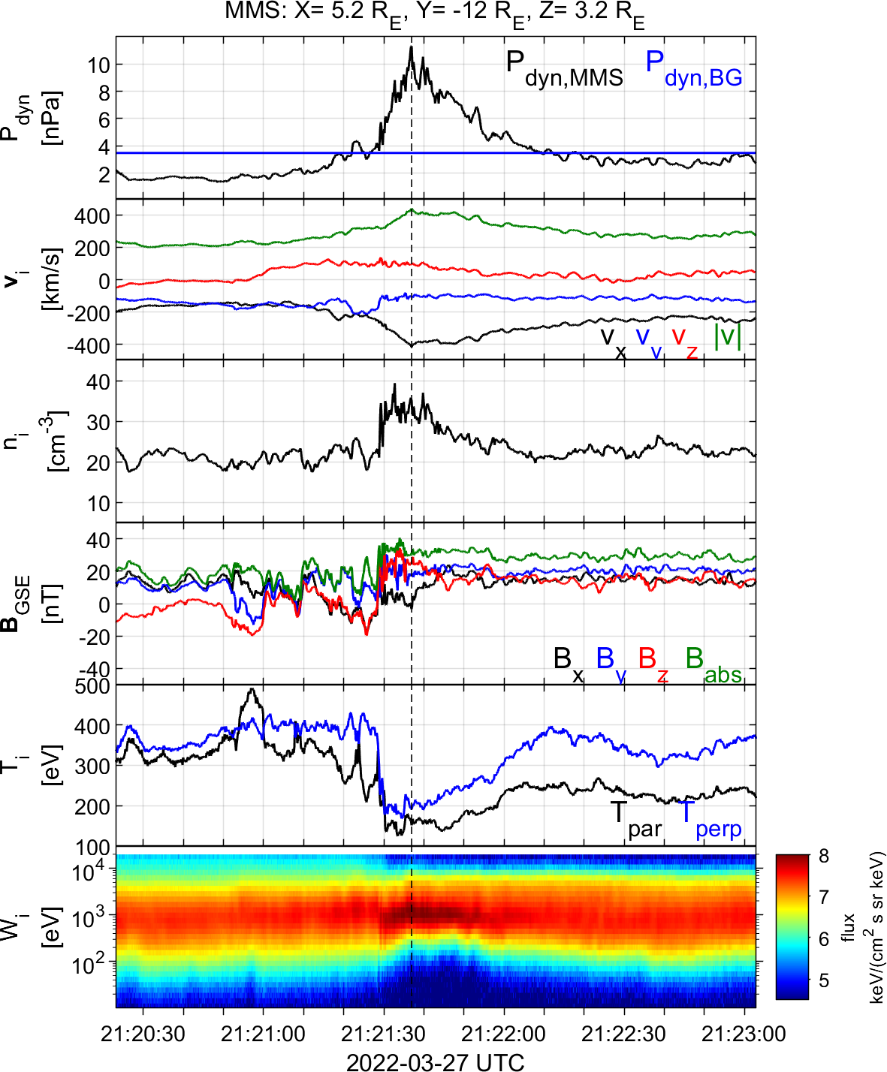



Magnetosheath High-speed Jets
Multi-mission observations of a high-speed jet associated to a solar wind discontinuity
Results
High-speed jets are transient enhancements of density and/or velocity. They are mainly found downstream of the quasi-parallel bow shock, while their origin is typically associated with shock’s non stationarity (i.e., shock rippling, foreshock transients, & global reformation).
Here we show a different scenario of boundary jet(s) being SW driven (i.e., due to an upstream discontinuity), captured by three different missions (MMS, THEMIS, and Cluster).
UPSTREAM
S. Raptis^{1,2}, C. P. Escoubet², T. Karlsson¹, L. Vuorinen³, et al.
¹Space and Plasma Physics, KTH Royal Institute of Technology, Stockholm, Sweden, ²ESA/ESTEC, Leiden, The Netherlands, ³Department of Physics and Astronomy, University of Turku, Turku, Finland
“Downstream high-speed jet(s) observed throughout the magnetosheath associated to an upstream DC”
Datasets & Method
DOWNSTREAM
WIND/THB/THC: Upstream of the shock, B variations observed.
THA/THE/THD: Downstream of the shock, first observations of jets. THD contains burst (high-res) measurements.
MMS: Fast and burst (high-res) measurements, showing the evolution and structure of jet.
Cluster: Preliminary data available, showing similar flow variations.
Qpar
Qperp
Qpar
Qperp
?
?
?
?
DC
DC
Discussion
High-speed flows forming in different locations (i.e., MMS, Cluster, THEMIS) associated to an upstream solar wind magnetic structure (WIND, THEMIS). These “boundary” jets are found at the regions where quasi-parallel magnetosheath turns quasi-perpendicular.
The properties of the jet(s) change from one location to the other. MMS observes more than twice the increase in $P_{dynx}$. In the future, we plan to investigate variability in scale sizes, background flows, and 3D structure of the observed jet(s)
Conjunction based studies such as this one can help us understand the origin and evolution of dayside transient phenomena. See preliminary lists of conjunctions on: https://www.cosmos.esa.int/web/csa/mms-themis-conjunctions or contact for custom lists (based on S/C separation and/or distance from boundary surfaces).
Ongoing work: feedback/suggestions/ideas really appreciated!
Learn about the kinetic structure of jets here or
about jets forming due to global shock reformation here
Contact info: 📧 savvasraptis@pm.me | 🔗 savvasraptis.github.io

